Slide 1
Salt Gradient Solar Pond
Chris Cirone

Slide 2
Solar Energy Collection and Storage
Uses radiation from sun to heat water
Stores sensible heat in dense saline water
Utilizes density gradient to prevent convective heat flow and therefore store thermal energy.
3 Main layers in salt gradient solar pond
UCZ: upper convective zone
NCZ: non-convective zone
LCZ: lower convective zone

Slide 3
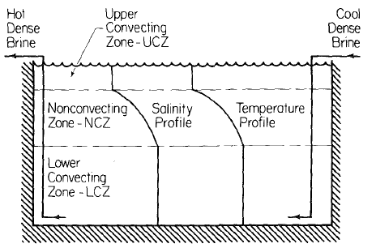
Solar Pond Diagram
20-30% salt conc.
70-90 C
(Newell and Boehm, 1982)

Slide 4
Brief History
Phenomena first discovered in early 1900’s in Transylvania where with natural occurrence.
Significant research effort and publications began in 1960’s mostly in Israel.
Interest subsided until the energy crisis of the 70’s during which the research effort expanded globally.
Solar pond research comes to UIUC in 1980’s.

Slide 5
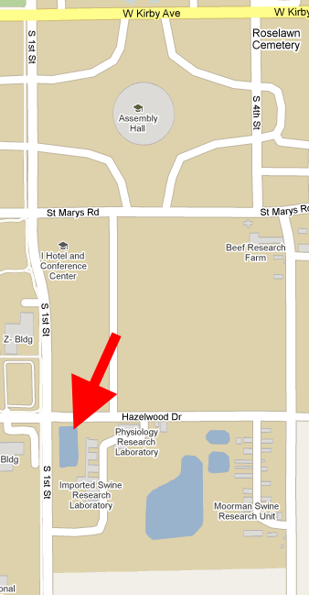
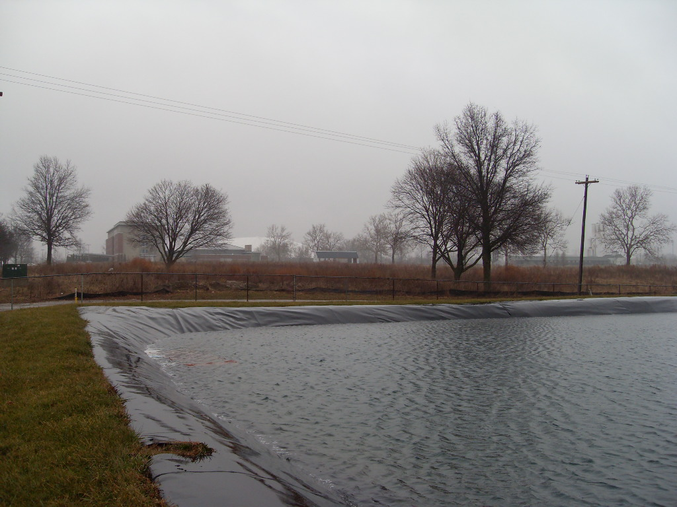
University of Illinois
Solar Pond
http://www.newellinstruments.com/equinoxblog/122309.html

Slide 6
University of Illinois Solar Pond
Research lead by Ty Newell from Mechanical Engineering
Constructed in 1986-87
2000 m² salt gradient thermal energy storage solar pond
Adjacent to hog research facilities which were partially heated by the pond during its active research phase.
Cost: 35 – 50 $/m² or 140,000-200,000 $/acre
Expected payback: 7-11 years
Cost per Sq. Meter
(Newell et al, 1990)

Slide 7
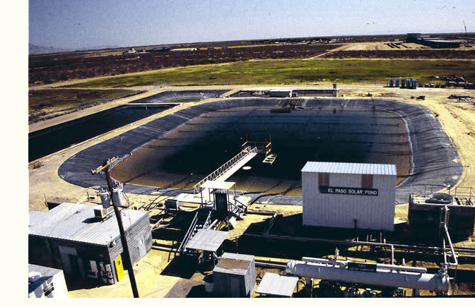
Typical Construction
Size can range from hundreds up to thousands of square meters in surface area.
Range from approximately 1-5 meters deep.
Typically lined with a layer of sand for insulation and then a dark plastic or rubber impermeable liner material.
Typical salt used is sodium chloride. Magnesium chloride, sodium nitrate, sodium carbonate, sodium sulfate also reported to be used.
El Paso Solar Pond

Slide 8
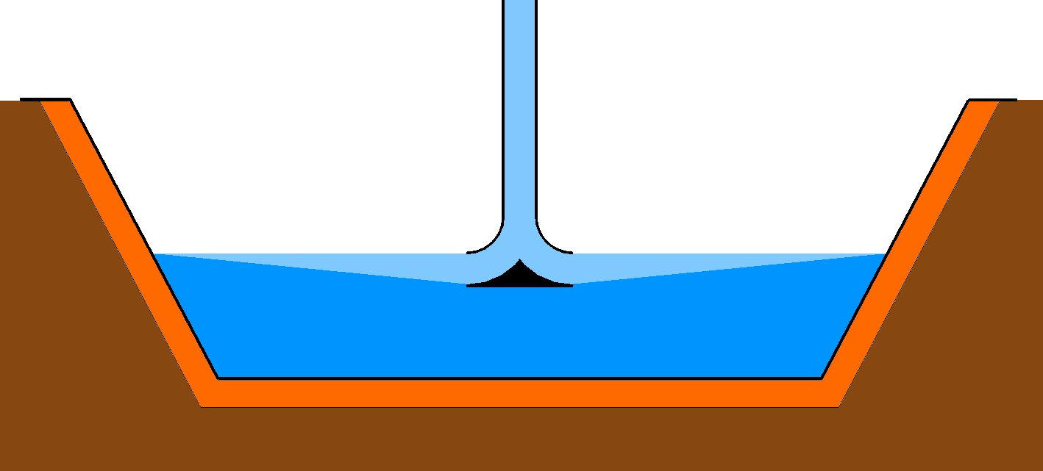
Forming the Salt Gradient
High concentration brine solution mixed in bottom to form the storage layer.
Layers of decreasing salinity “stacked” on top of the storage layer using a horizontal diffuser.
Fresh water is the final layer pumped on the surface.
Zangrando (1980)

Slide 9
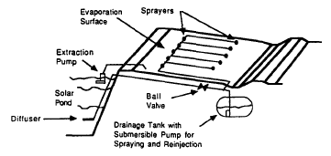
Maintaining the Gradient
Salt diffuses to surface trying to homogenize the solution- artificial maintenance required
Temperature distribution has destabilizing influence on pond
Charging pond destabilizes
Energy extraction stabilizes
Stability of gradient layer is dynamic
Other destabilizing factors: surface wind, gradient maintenance flows, convection in storage layer
Brine Re-concentration System
(Newell et al, 1990)

Slide 10
Applications
Greenhouse heating
Process heat in dairy plants
Desalination
Power generation
Agricultural applications
Drying crops
Heating livestock buildings
Building space heating and absorption cooling

Slide 11
Organic Rankine Cycle
Rankine cycle that uses an organic, high molecular mass working fluid with boiling point lower than water.
www.powerfromthesun.net/Chapter6/Chapter6.htm

Slide 12
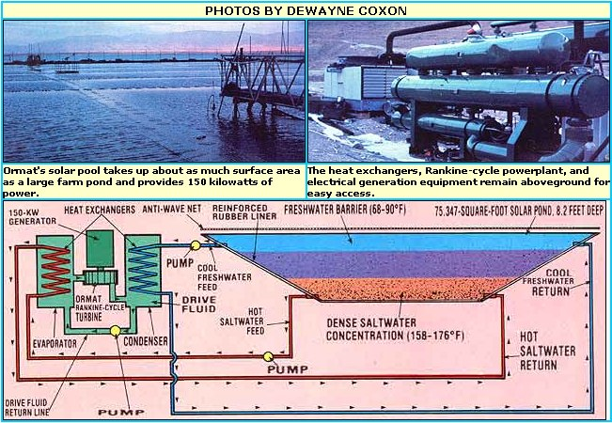
Pilot Plant in Israel (1980’s)
http://www.motherearthnews.com/Modern-Homesteading/1980-05-01/Israels-150-KW-Solar-Pond.aspx

Slide 13
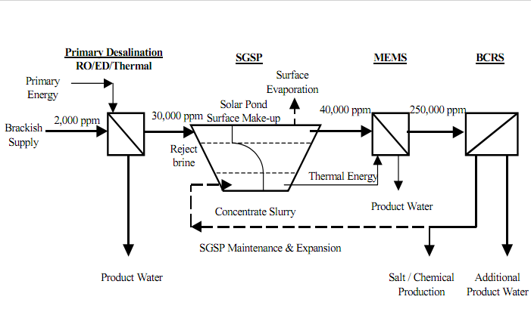
“Zero Discharge” Water Desalination
RO: Reverse Osmosis
ED: Electrodialysis
MSF: Multi-stage Flash
MEMS: Multi-effect multi-stage
BCRS: Brine Concentrator and Recovery System

Slide 14
Process Heat for Milk Pasteurization in India
http://www.youtube.com/watch?v=KHCheEghok0

Slide 15
Design Improvements
Reduce wall shading
Increase ground insulation
Uses mirrors to increase insolation
Honeycomb insulation on surface
Prevent convection heat loss and wind disturbances

Slide 16
References
F. Zangrando, A simple method to establish salt gradient solar ponds, Solar Energy, Volume 25, Issue 5, 1980, Pages 467-470, ISSN 0038-092X, DOI: 10.1016/0038-092X(80)90456-9.
Zangrando, F. On the hydrodynamics of salt-gradient solar ponds (1991) Solar Energy, 46 (6), pp. 323-341.
Velmurugan, V., Srithar, K. Prospects and scopes of solar pond: A detailed review (2008) Renewable and Sustainable Energy Reviews, 12 (8), pp. 2253-2263.
Newell, T.A., Cowie, R.G., Upper, J.M., Smith, M.K., Cler, G.L. Construction and operation activities at the University of Illinois Salt Gradient Solar Pond (1990) Solar Energy, 45 (4), pp. 231-239.
NEWELL, T.A., BOEHM, R.F. GRADIENT ZONE CONSTRAINTS IN A SALT-STRATIFIED SOLAR POND. (1982) J SOL ENERGY ENG TRANS ASME, V 104 (N 4), pp. 280-285.

